Slide 1


Supply chain management using blockchain
Presented by
BYTEam
Members:
- Priyadharshini Jayadurga N
- Soundharya S
- Sushmabala S A
- Vishali V

Slide 2
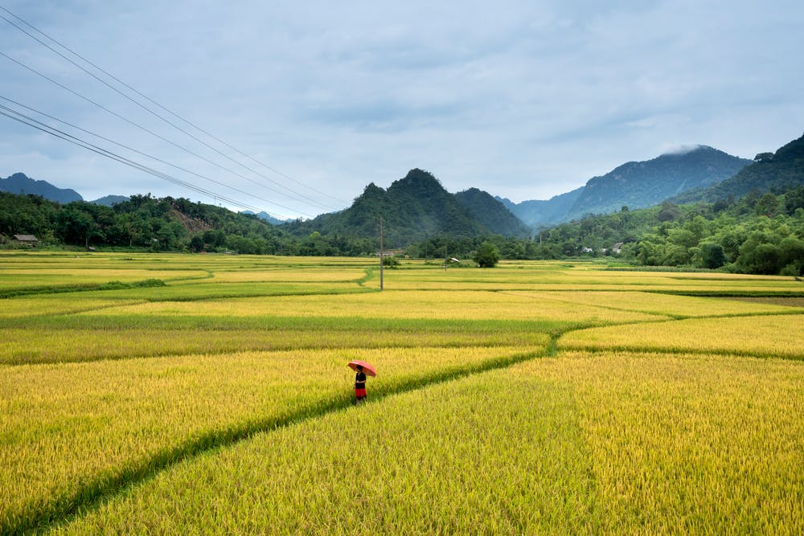
India and its villages
India ranks second in worldwide farm outputs.
75% of India lives in rural areas, which implies about 83.3 crore Indians are from villages.
Agriculture contributes to 17%-18% of the country’s GDP.
About 50% of the Indian workforce is employed in agriculture.
A huge portion of the income of villages comes from agriculture.
Thereby, Agriculture forms the backbone of Indian economy.

Slide 3
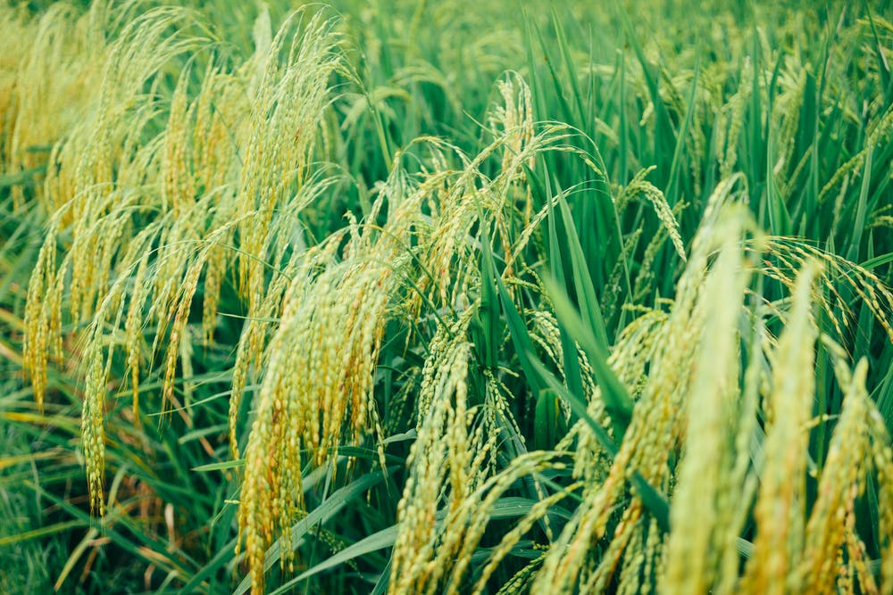
Supply chain management
Supply chain management and optimization is an integral part of most businesses
Reduces overhead
Improved quality control
Controlled intruders
BLOCKCHAIN TECHNOLOGY ENABLES:
Better visibility of the supply chain
Better monitoring of goods
Transparent but secure

Slide 4
Existing system
Storage of finished products
Updating stock
Order placed
Transportation
Distribution
Supply Chain

Slide 5

Proposed system
Innovative mobile and web based application
Enables farmers to sell products directly to the customers
Zero intruders
Revolutionizes existing supply chain
Based on e-commerce.
Integration of supply chain

Slide 6

Why Blockchain?
Data driven approach
Better collaboration
Improved quality control
Reduced overhead costs
Lower risks in delivery of product
Secure

Slide 7



Our fresh produce promise
Local
Fresh
economic

Slide 8




Farmers'
Grow
Harvest
Update

Slide 9
Customers’
Search Product
Add to cart
Checkout

Slide 10
IMPLEMENTATION

Slide 12
IMPACT OF PROPOSED SOLUTION
The anticipated target beneficiary group was assumed to be about 178 villages.
Number of people was around a lakh.
A web based application was created where
Farmers upload crop details
The farmer himself decides the selling price and updates it
Customers on the other hand, view items
Order them and get them delivered
Customers pay the cost fixed by the farmer along with the cost of transportation

Slide 13
FINANCIAL IMPLICATION FOR THE VILLAGE
THERE IS ABSOLUTELY NO FINANCIAL IMPLICATION INVOLVED FOR THE VILLAGE
Provided, people know to operate basic computer and can work with keyboards and touch pads.
If otherwise, training would be required to train the farmers on how to use the web based or mobile based application according to their changing needs.

Slide 14
Thank you

